Slide 1
Episode # ?
Title

Slide 2
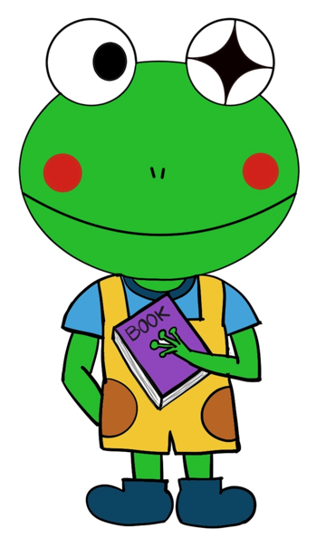
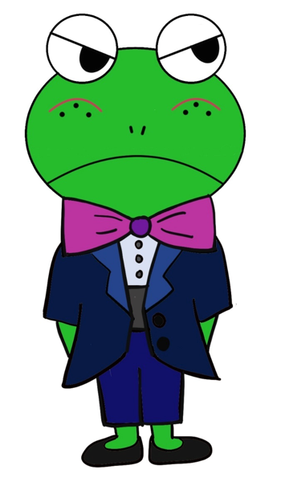
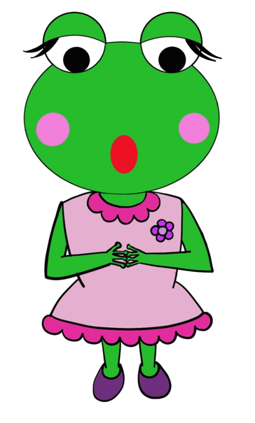
Starring
Curious Felix
Grumpy Frankie
Timid Fiona

Slide 3
Background of 1st and 2nd Page illustration) In front of Fiona's house, Fiona, Curious Felix, and Grumpy Frankie chat with each other.
Prefer a single illustration spanning across two pages when the book is opened. Also, prefer fairy tales that are a total of 18 to 20 pages in length.
1st Page
2nd Page
"Ugh, I hate Felicia! I hate her so much!“ Curious Felix and Grumpy Frankie are surprised to find Timid Fiona shouting so furiously.
"Hey, calm down. What did your sister do to you?" Felix asks. "If you grumble like that, I'll start calling you my baby sister, Grumpy Fiona," Frankie says with a laugh.

Slide 4
Background of 3rd and 4th Page illustration)
3rd Page
4th Page

